Slide 1
My Care
Presented by Ilir Krijezi

Slide 2
Introduction
This presentation is provided to help you understand the concept and simplicity of adding your healthcare data into a web dashboard and having a clear overview of the symptoms you have, rather than having to go over lines and lines in a sentence and getting overwhelmed with technical medical words.
Problem Statement: I have decided to focus on this area, because after various background research with other web dashboard providers, I have concluded that there is a big lack in clear visualization, a very poor quality of overlay, leaving the user confused as to where to find things, no clear structure and guidance as to what the focus areas are like big graphs, statements and procedures, etc. and a big question mark of the user when it comes to the question what the next steps to act are.
I have made the decision to create a web dashboard, with the aim that it provides:
Clear Visualization
A structure guiding the user around the System.
Accessibility: To provide clear overlay, so that users can confidently stroll through the System, knowing exactly where to find something and access it accordingly
Both easy to access, and some tips of what to do next

Slide 3

Aims and Objectives

Slide 4
Aims
Clear Visualization
A structure guiding the user around the System.
Accessibility: To provide clear overlay, so that users can confidently stroll through the System, knowing exactly where to find something and access it accordingly
Both easy to access, and some tips of what to do next

Slide 5

Objectives
To have made a survey with family and friends regarding their current health status, which I can use to get some insights of what the web dashboard should include.
Analyzing data visualization such as graphs, charts, etc.
To implement real time updates regarding the overall facility of the web dashboard.
To evaluate the outcome by getting feedback from the users and improve the needed departments.
To reflect on the results and findings and provide support and help where needed.
To meet the legal and regulatory requirements, such as that the web dashboard meets applicable laws and industry standards of the client.

Slide 6

Literature Review

Slide 7
"The lack of accessibility across the web has been a documented problem, from government websites, to social media, to productivity tools. Various studies highlight the intricate relationship between accessibility and usability and its impact on screen reader users’ navigation of the web." - Danyang Fan (29 March 2023), 'The Accessibility of Data Visualizations on the Web for Screen Reader Users: Practices and Experiences During COVID-19', ACM Transactions on Accessible Computing, Article No.: 4pp 1–29

Slide 8

Analysis, Design and Specification

Slide 9
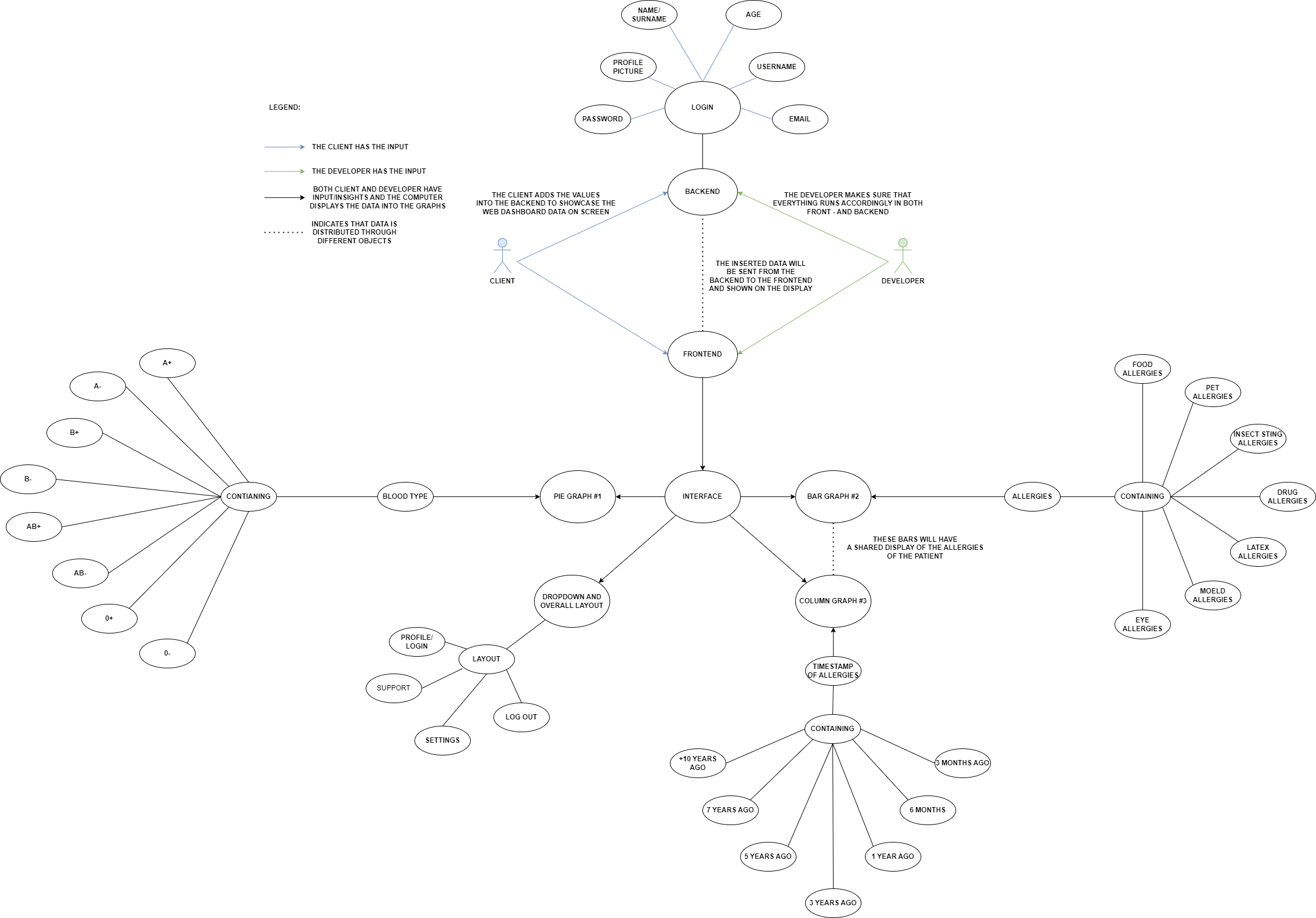
Use Case

Slide 10
Research Focus
The main theme of this research revolves around the pivotal role of web dashboards as catalysts for data-driven excellence. In the digital age, where data is prolific and complex, web dashboards have emerged as transformative tools that empower organizations and individuals to harness the full potential of data for improved decision-making and operational efficiency. This theme encompasses the following key aspects:
Enhanced Data Visualization: Web dashboards serve as a medium to translate intricate data into clear, visual representations. By facilitating interactive data visualization, they enable users to quickly grasp insights and trends that might otherwise remain hidden within the data.
Real-Time Insights: Web dashboards provide access to real-time or near-real-time data, enabling immediate responses to changing conditions. This dynamic aspect is crucial in sectors where timely decisions are critical, such as finance, healthcare, and e-commerce.
Customization and Accessibility: Dashboards are highly customizable to cater to the specific needs and preferences of users. Moreover, their accessibility on various devices and platforms ensures that data insights are available at the users' convenience.
Data Integration: Dashboards can integrate data from multiple sources, breaking down silos and providing a holistic view of an organization's or individual's data landscape. This integration is essential for comprehensive decision-making.
Decision-Making Empowerment: Web dashboards empower users with the ability to track key performance indicators, monitor operations, and identify trends and anomalies. They facilitate data-driven decision-making, contributing to overall excellence in various domains.
Collaboration and Communication: Dashboards promote collaboration and communication among stakeholders by allowing for data sharing, commentary, and collaboration features. This fosters teamwork and enables organizations to collectively derive insights from the data.

